Slide 1
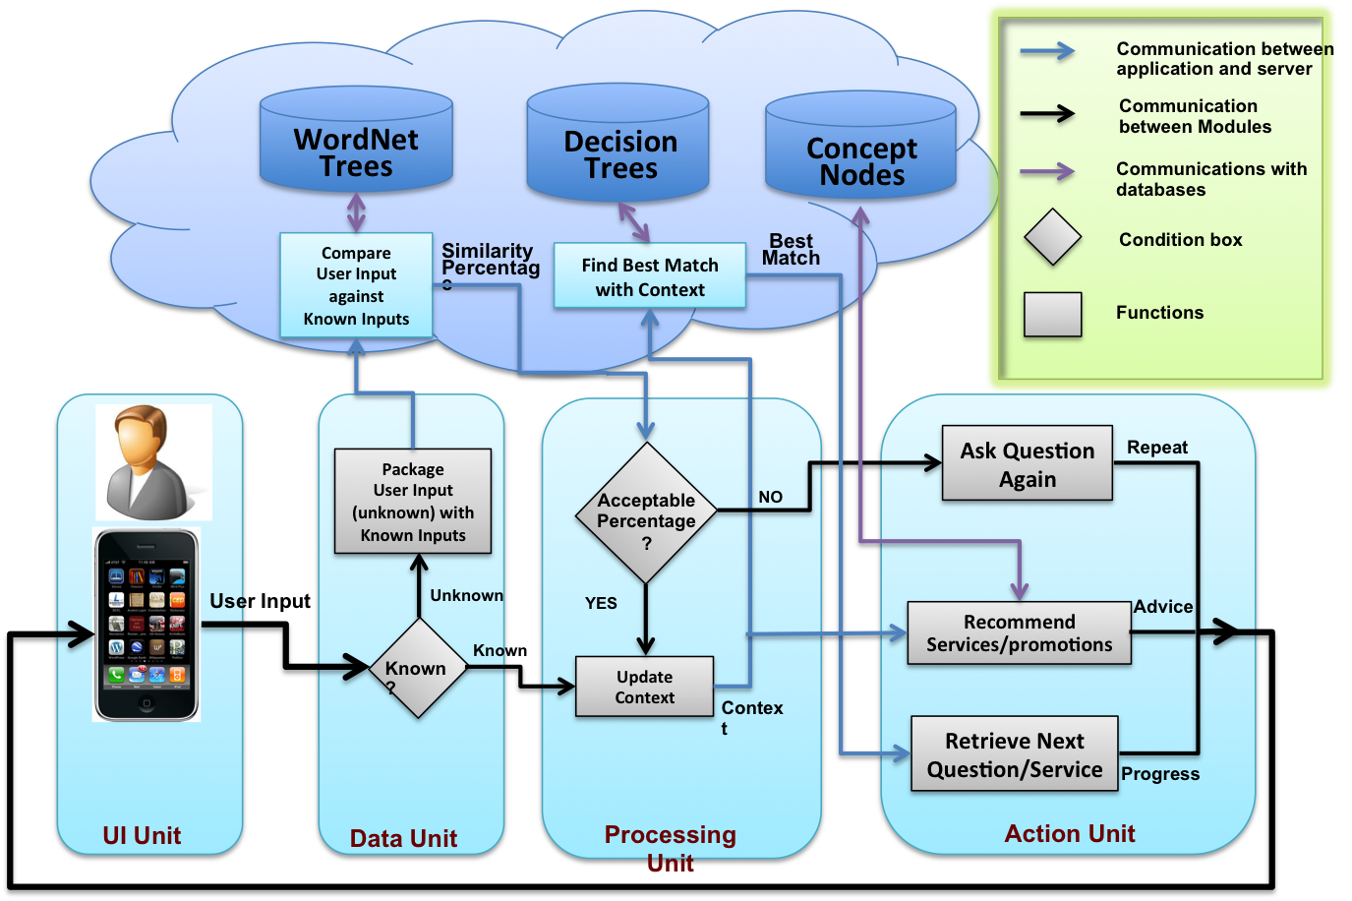
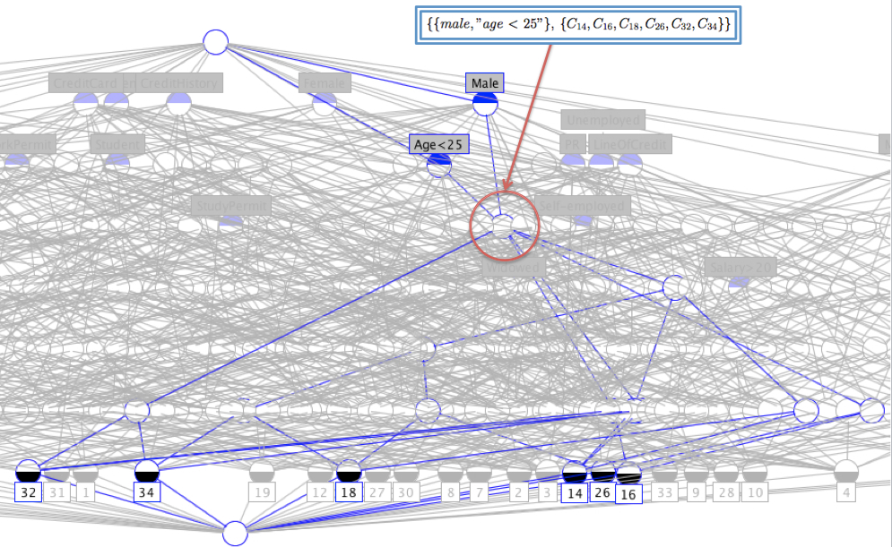
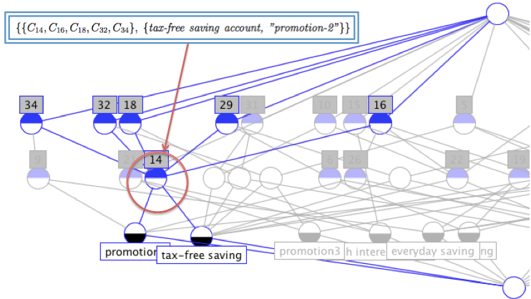
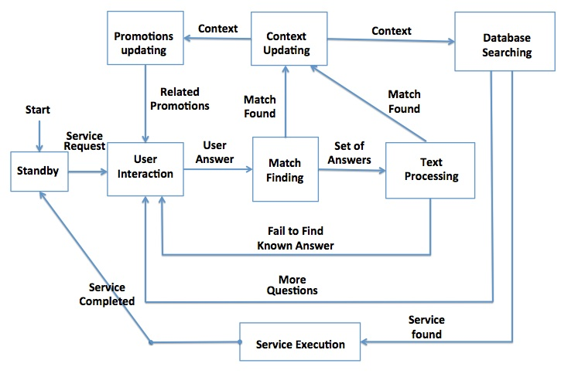
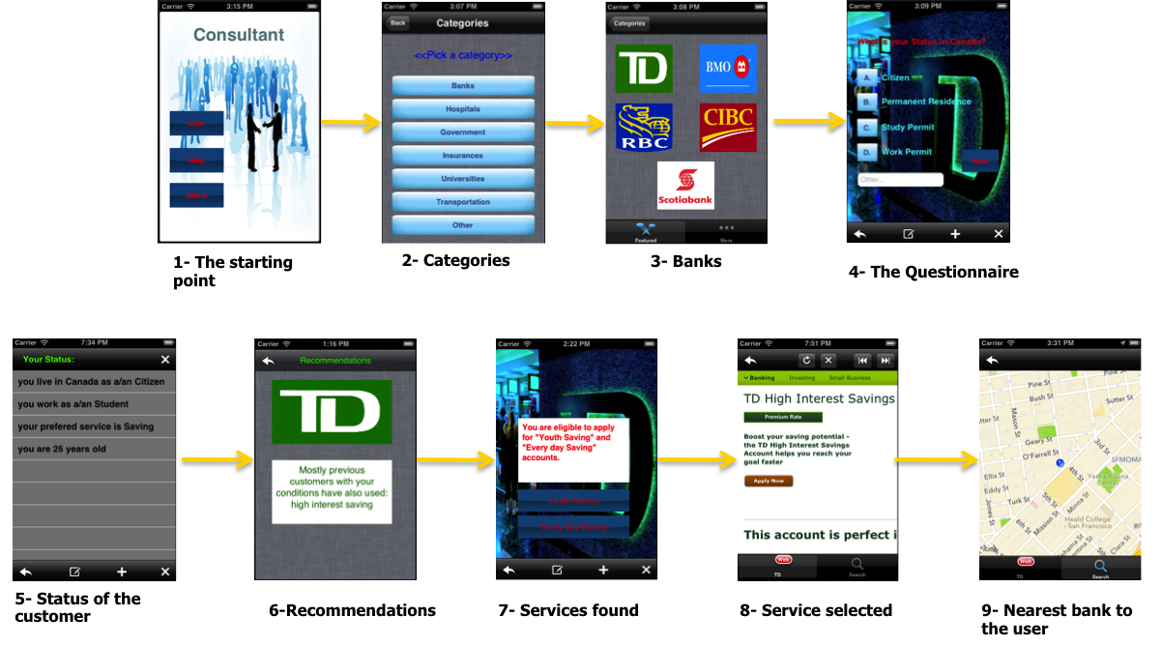
Consultant-as-a-Service: An Interactive and Context-driven Approach to Mobile Decision Support Services
Ahad Yarazavi
Kamran Sartipi
University of Ontario Institute of Technology
{Ahad.Yarazavi, Kamran.Sartipi}@uoit.ca
Consultant-as-a-Servirce
Architecture
Approach
FEATURES:
A Web-Based Decision Support Service which is suitable for large organizations
Uses semantic-analysis to understand user’s input
Requires minimum user knowledge
Uses data mining to recommend similar services to the user
Server is deployed on the cloud infrastructure
Designed for smart devices– iPhone
The framework is designed based on a context which should be defined for each organization separately.
Context is defined as all the information in which the organization needs from a user in order to use all the services in that organization.
This research introduces a new generation of cloud-based service provisioning, where the users with no prior-knowledge about an organization’s list of services, can conveniently and effectively use those services in companion with trusted utility services.
The user installs a new type of customizable agent in her mobile device and requests to be advised for services that a particular organization (e.g., City-bank) provides. The cloud provider sends the City-bank decision support service to serve the user, which collects the context of the user locally to select a specific business service (e.g., stock investment). The cloud provider then sends specific instructions to the customizable agent to customize it at the mobile device to redirect the user to the web page where the user can apply for the chosen service. Each service interface description in the cloud is annotated with an attribute-tuple, namely ”service-context” such as: <domain, role, operation, data, expertise, security, cost>. Each attribute is associated with a list of known attribute-values as well as a number of semantically related synonyms based on expert’s knowledge to characterize that attribute-value. The relationships between attributes, attribute-values, and synonyms are managed within the WordNet framework. As a case study, we modeled the system in a Banking environment. The mobile decision support service performs a series of interactions with the user to identify a proper attribute-value for each individual attribute of the service-context.
Decision Support System
<<Citizen, Employee, Saving>>
How much money do you desire to put in your saving account at start?
Concept Lattice Analysys
<5000
>5000
<<Citizen, Employee, Saving, <5000>>
<<Citizen, Employee, Saving, >5000>>
Organizations have records of their existing and past customers and their preferred services.
Consultant-as-a-Service uses customer databases to recommend service to new customer
Tax-Free Saving
- Every day Saving
Are you planning to use your money while it is in the saving account?
No
Yes
<<Citizen, Employee, Saving, >5000, No>>
<<Citizen, Employee, Saving, >5000, Yes>>
High Interest Saving
Tax-Free Saving
- Every day Saving
The proposed Framework
The framework provide interactive and mobile decision support services in large organizations that guide the customers to identify their desired services through guided questions that are derived from the customer’s personal context.
Experimentation
We investigated several services offered by the TD Bank and the circumstances to apply for each service. Based on the gained knowledge we designed the attribute-tuple for TD Bank as: <Status, Occupation, TypeOfService, Age, AmountOfMoney, UseOfMoney, CreditHistory, Degree>. This attribute-tuple is the user’s context that we try to identify its attribute values, and based on the evaluated context we will be able to suggest the most relevant services to the user. Each element in this tuple has an attached question along with possible answers which the system should understand (i.e., known answers). Decision trees are designed with respect to the attribute-tuple and the next proper question to ask.

