Slide 1

ABM Machine: AutoMac
Monday, December 3rd
Software Engineering
4M04
Dr. Kamran Sartipi
By:
Ramon Tiongson
Belal Abou Shaar
Monica Jain

Slide 2
Overview
Software engineering is the application of engineering to software
Software engineering guides many engineering disciplines.
Software engineering involves design, analysis and systematic implementation of various systems.
It sets the conciseness by using such methods as SRS, SDS and numerous other tools.

Slide 3

Software Engineering Applications
Science.
Technology.
Supply Chains.
Implementation Systems.
Principle Settlements.
It is used for the organization of any system to produce more effective designs.

Slide 4
Goals of Professional Software Engineering
Reduce wasteful designs
Creating more robust designs.
Presenting methodological approaches to solving dissatisfactory engineering dilemmas.
Account for various requirements and specifications from the user.
Divert efforts away from compromising designs to copyrights and trademarks.

Slide 5
Software Development Process
“Software Development Process“ (SDP) is a process of refining different software artifacts at different levels

Slide 6
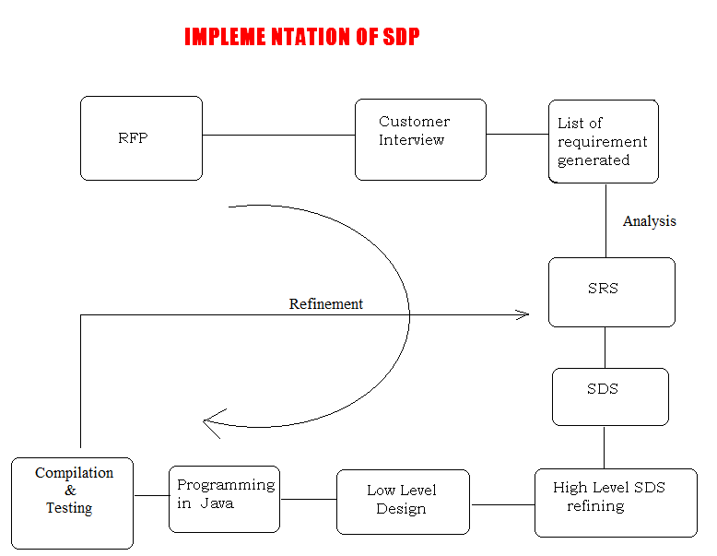
SDP Diagram

Slide 7
Implementation of SDP
Short and abstract Request for Proposal (RFP) was received.
Investigation of filed banking system helped to generate large list of features which was discussed with the customer during the customer interview.
RFP was refined and a complete list of requirements was generated.
SRS document was produced and analyzed using different design techniques .
SRS was refined into UML component diagram as high-level SDS (techincal and user friendly)
High-level SDS was refined using techniques for low-level design such as modularity, UML class diagram, sequence diagram and statecharts
low-level design that is a refinement of high-level design was generated.
At last low level design was made and using the java programming it was implemented.
Then java program can be converted into Assembly and machine language codes that was performed by Java compiler

Slide 8


SRS: Software Requirement Specification
Transaction
User Interface
Vault
Database

Slide 9

SDS: Software Design Specification
Phase 1: Authentication

Slide 10
Client
1
2
3
4
Phase 2: Client Transaction
-Deposit
-Withdraw
-Pay Bills
-View Balance
-Transfer Money

Slide 11


Administrator
Phase 3: Maintenance
-Maintain Balance
-Update Customer Information
-Activate, Deactivate and Unlock Accounts

Slide 12
Conclusions
A step-by-step implementation saves resources and results in a better design.
SDS and SRS are excellent ways to approach the design of a system.
Performance is improved when revised by a cognoscente team at every step of implementation.
We has implemented SDP successfully which has led to a good design.

Slide 13

Thank You!
Questions and Answers

