Slide 1
Automated banking machine
Presented by Group: 110:
Byron Sinclair, Jacob Alexander, and Manmeet Singh

Slide 2
What is Software Engineering?
An engineering discipline for software:
  Development
  Operation
  Maintenance
Also involves:
  Managing teams
  Scheduling
  Budgeting
Methodology for large software projects

Slide 3
Why Software Engineering?
The Software Crisis:
For every 8 large projects, 2 are cancelled.
Most projects exceed their time-schedule by 50%.
75% of large software systems malfunction after completion.
Detecting and correcting errors take 50% of time and effort.
Maintenance cost of a system is 60% of entire cost.
Software engineering tackles the software crisis by providing disciplined processes and methodologies to design, implement, and maintain large systems.

Slide 4
The Software Life Cycle Process
Requirements gathering and analysis
Architecture design and specification
Coding and testing
Delivery and deployment
Maintenance and evolution
Retirement

Slide 5
The Waterfall Process
Feasibility study
Design
Requirements
Coding and module testing
Integration and system testing
Delivery, deployment and maintenance

Slide 6
SRS
Complete description of the behavior/requirements of system to be developed
  Functional Requirements
    What does the product need to do?
  Nonfunctional requirements
    What are the product constraints?

Slide 7
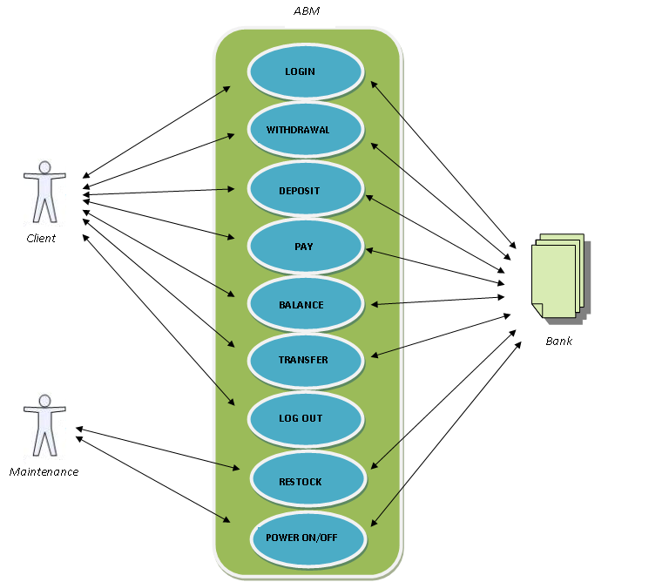
Use Case View

Slide 8
SDS
Complete description of the software architecture/design and the rationale behind it
  Architecture
    Components
  High level design
    Interface interaction
  Low level design
    Modules

Slide 9
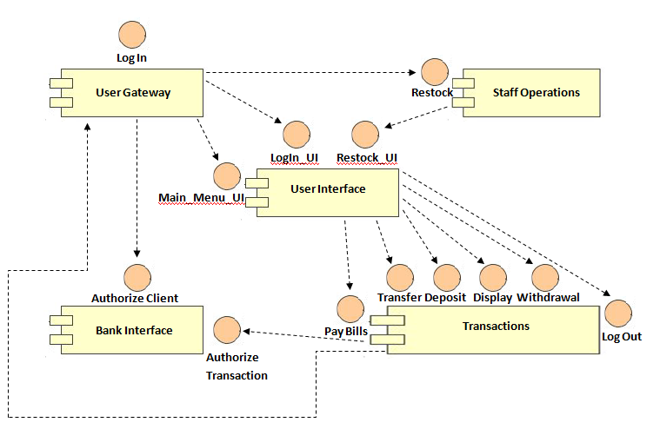
Component Diagram

Slide 10
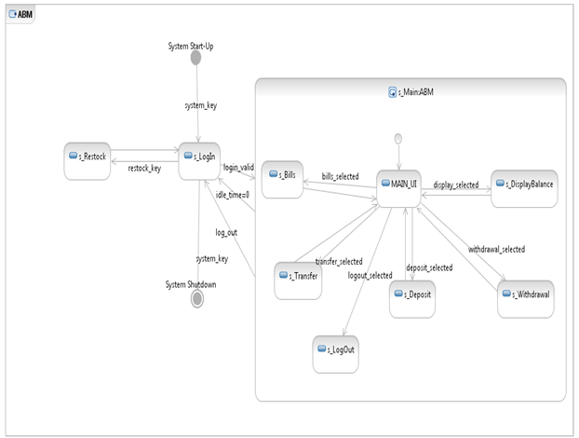
System Statechart

Slide 11
Implementation in Java:
User Interface
Replicated the ABM system’s hardware
Implemented using the awt library
Animations created with the canvas class and multithreading

Slide 12
Implementation in Java:
The Bank System
All data stored in a SQL database
HSQLDB was used since it is native to Java
Tables for:
  Clients
  Accounts
  ABM
Implemented basic methods for other interfaces

Slide 13
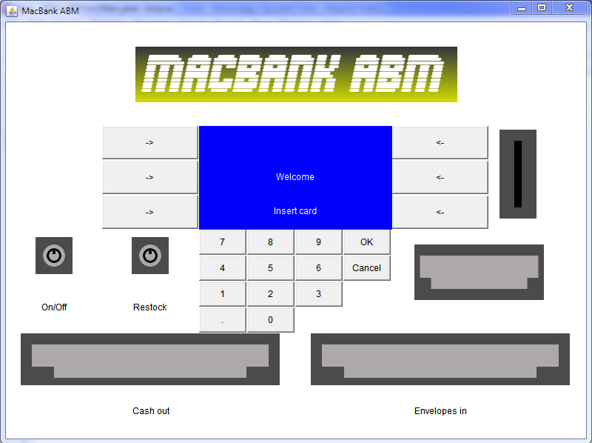
Log In

Slide 14
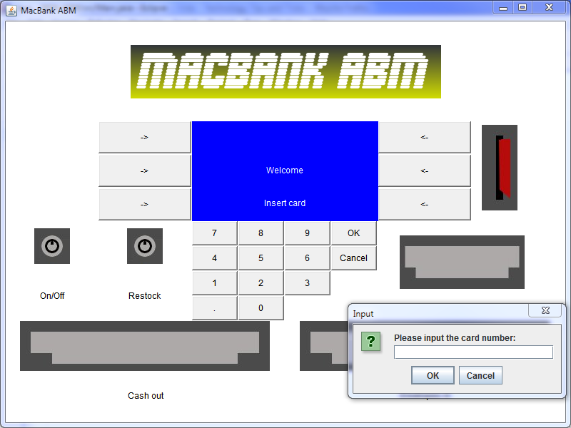
Log In

Slide 15
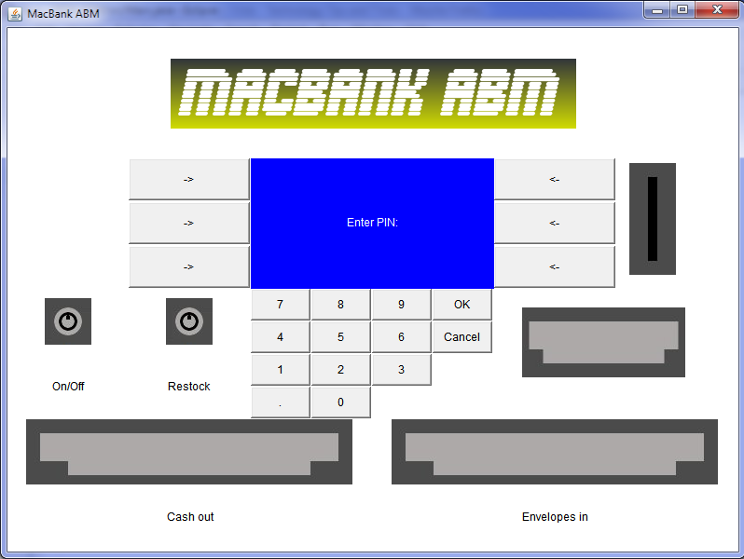
Log In

Slide 16
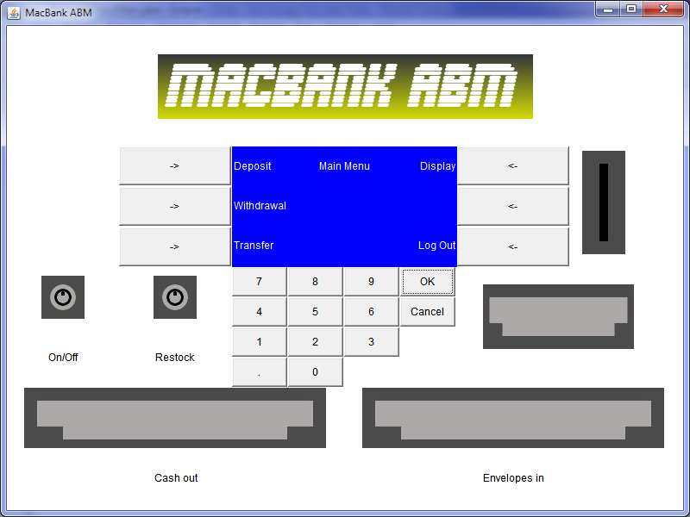
Main Menu

Slide 17
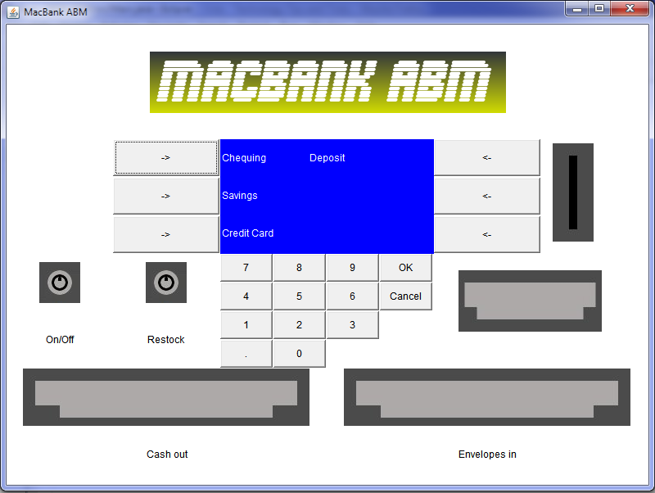
Deposit

Slide 18
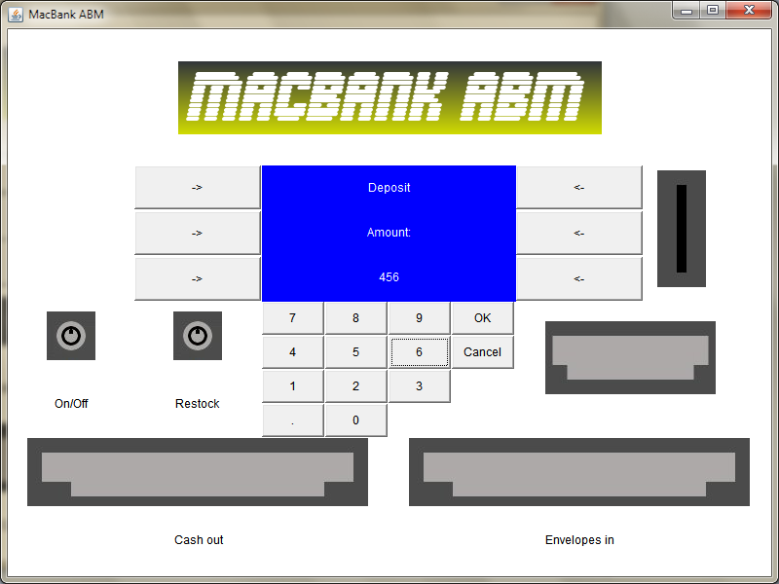
Deposit

Slide 19
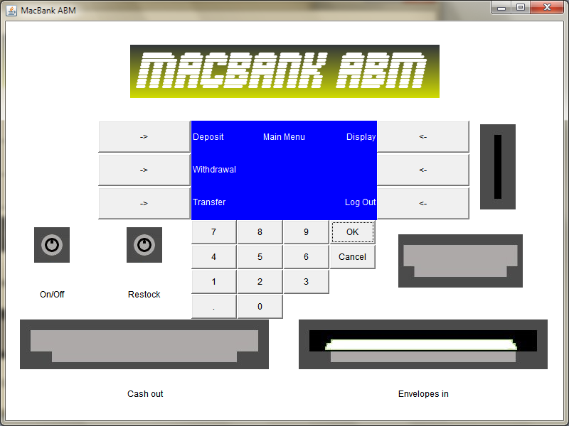
Deposit

Slide 20
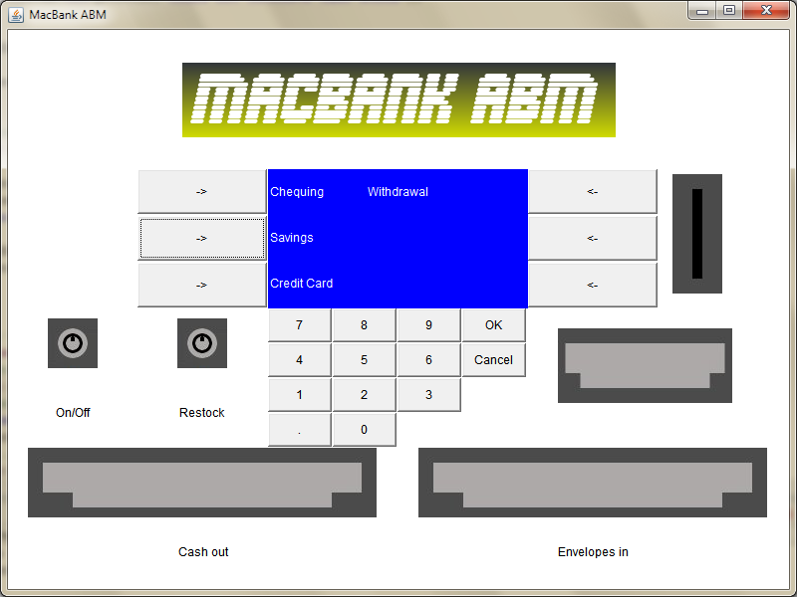
Withdrawal

Slide 21

Withdrawal

Slide 22
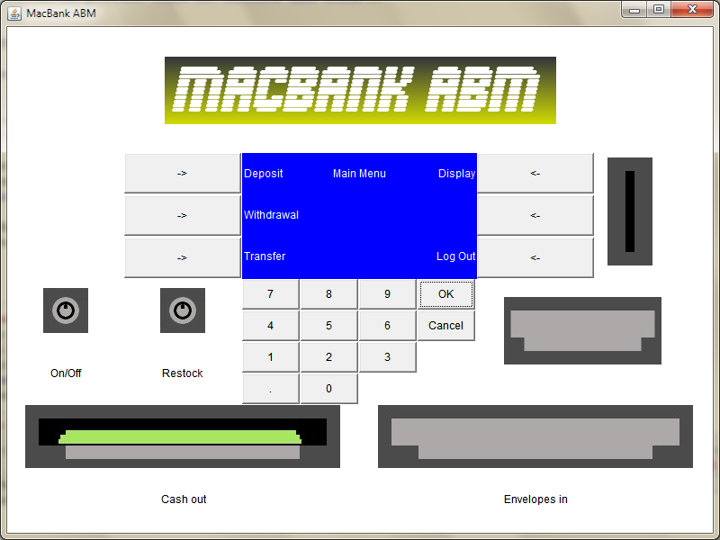
Withdrawal

Slide 23
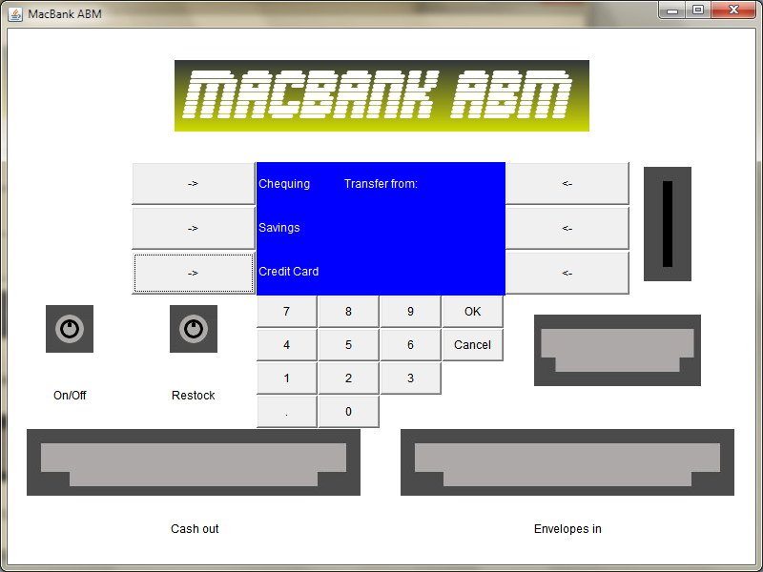
Transfer

Slide 24
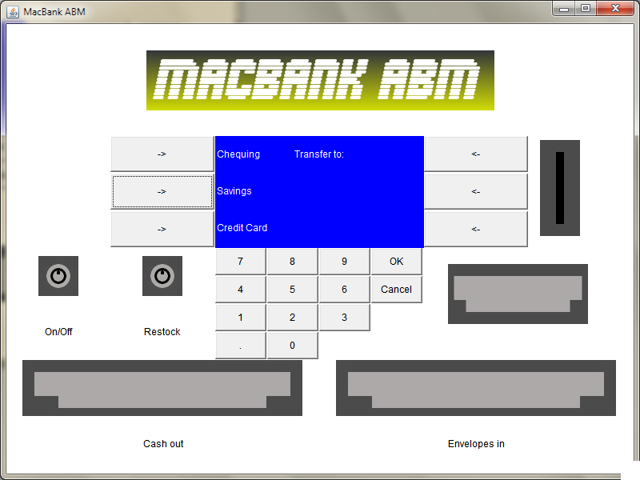
Transfer

Slide 25
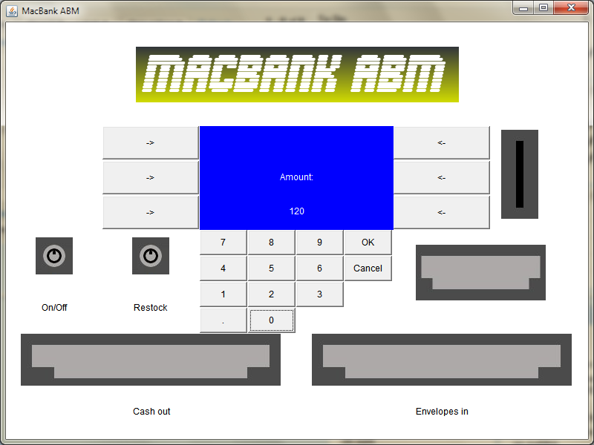
Transfer

Slide 26
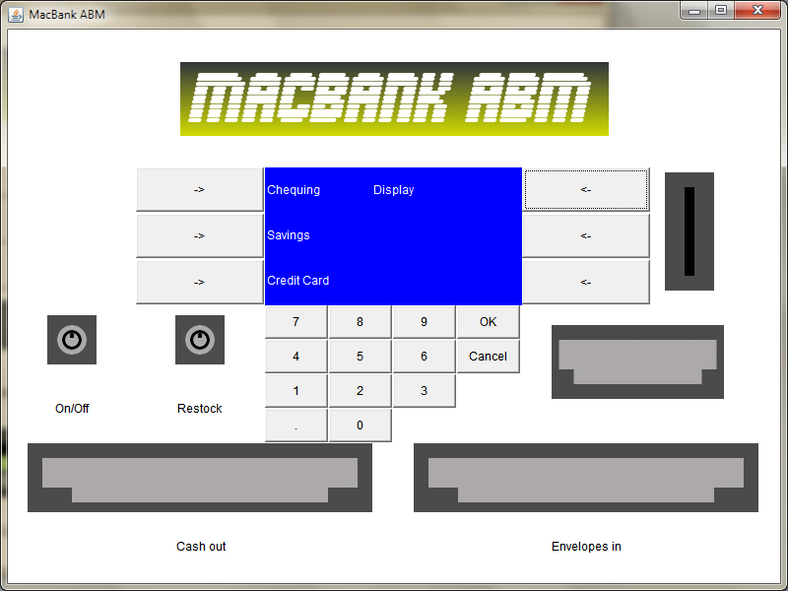
Display

Slide 27

Display

Slide 28
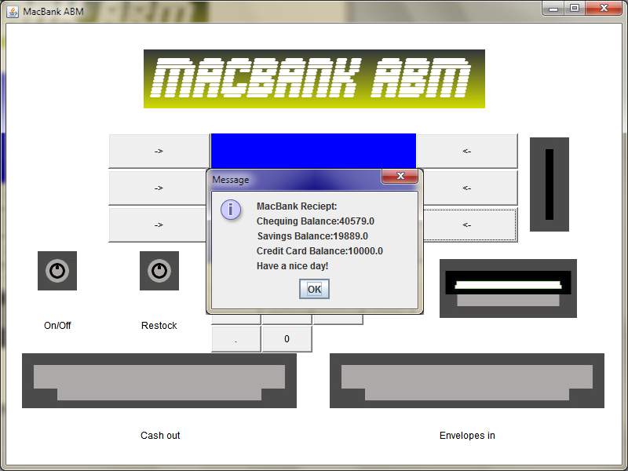
Log Out

Slide 29
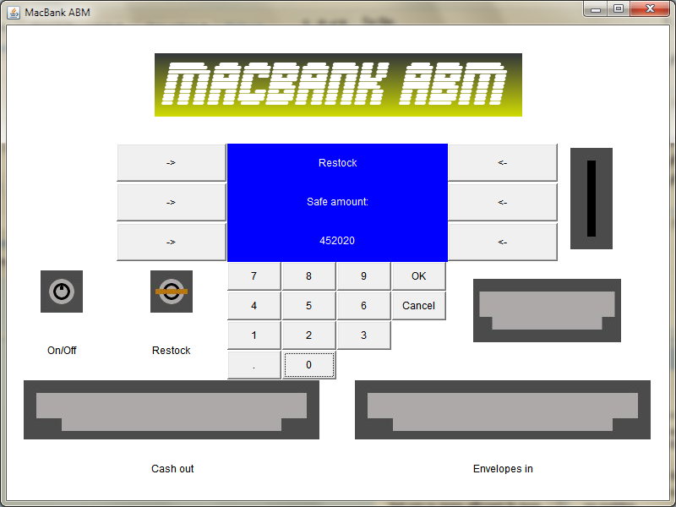
Restock

Slide 30
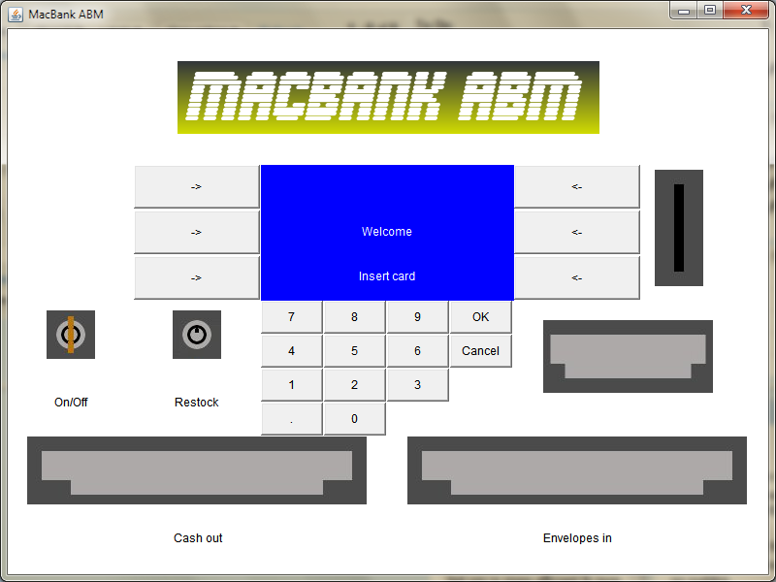
Switch Off

Slide 31
Conlusion
Software development involves more than coding
Software documentation process is provides excellent organization before implementation.
Suggestions for improvement:
For some of us, this is currently our fourth ABM implementation in either Java or C.
A previously unsolved problem would provide a better motivation for proper software documentation.

Slide 32
Conclusion
Questions?

