Slide 1

MacBankTM
^{ABM}
Presented by:
Yaseen Ali, Suraj Bhardwaj, Rohan Shah
Mechatronics Engineering
Group 302
Instructor: Dr. K. Sartipi
Course: SFWR ENG 3K04

Slide 2
Outline
Overview
SRS
SRS to High-Level SDS
High-Level SDS to Low-Level SDS
Implementation in C#
DEMO
Conclusion

Slide 3
What is Software Engineering?
Application of:
Systematic
Disciplined
Quantifiable
Approach to the development, operation and maintenance of software.
Study of these approaches is software engineering.

Slide 4
Software Engineering Crisis
Current state of software technology in dealing with development and maintenance of large and complex software systems.
Tackled by:
- Providing disciplined processes and methodologies to:
  Design
  Implement
  Maintain
  Large software systems.

Slide 5
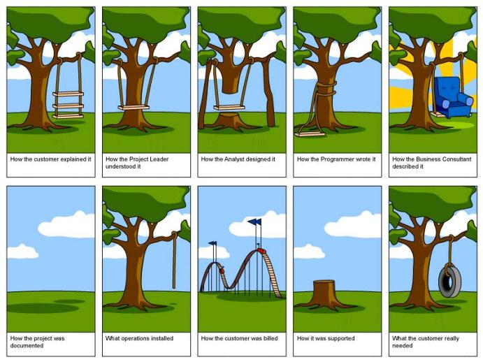

Slide 6
Software Engineering Project
Consists of computer programs and associated documentation, which includes:
SRS
SDS
Technical Manual
User Manual
Source
Binary Files
Build Files
Version

Slide 7

Why is it important?
Software engineering has had a major contribution in the development of the modern world. Software engineering is used in a variety of industries and applications:
Process automation:

Slide 8
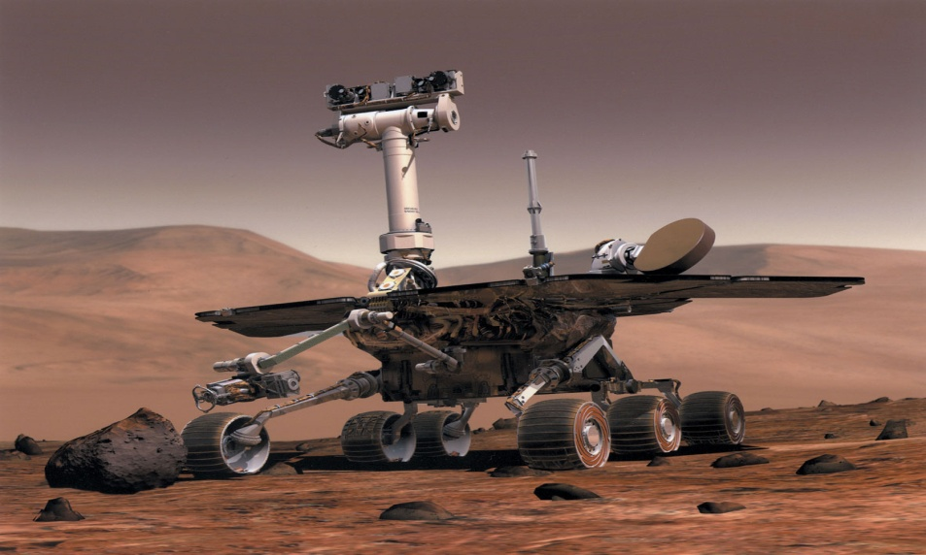
Why is it important?
Equipment control
Scientific problems
Entertainment industry
Education and office management

Slide 9
Software Life Cycle Models
Waterfall Model
Extensive Programming
Throwaway Prototyping Model
Spiral Model
Evolutionary Prototyping Model
OSS Development Model

Slide 11
Requirements Analysis and Specifications
After precise costs and benefits of the software have been defined.
Requirements are in end user terms.
Helps to make user manuals and system test plans.

Slide 12
Requirements and Specifications(ABM)
15 min interview with TA posing as MacBank representative.
RFP provided
Included basic banking requirements.
Staff requirements.

Slide 13
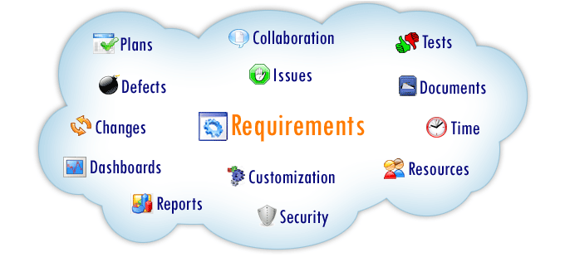
SRS Benefits
SRS is the initial step in the software life cycle.
SRS should contain everything there is to know about the system.
Focuses on the “what” not the “how”
It allows easy communication between individuals.

Slide 14
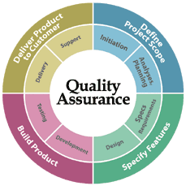
SRS and Quality
"The hardest single part of building a software
system is deciding precisely what to
build" (Frederick Brooks)
The Software Requirement Specification is an important step in providing a high quality software solution.

Slide 15
Features of SRS
Complete document specifying the goals of the system.
Clearly defined what qualities the application must exhibit.
Identified all stakeholders and defined the operating environment.
Did NOT include how the solution was to be implemented.

Slide 16
SRS Environment
From the RFP :
Able to understand the operating environment.
Translated requirements to Specifications document (SRS)

Slide 17
USE Case Diagram
Use Case diagram was used to specify the actors and actions in the system

Slide 18
Design and Specification
2 Sub-phases:
  Architectural or High Level Design
  Detailed or Low Level Design
  High Level: deals with overall module structure and organization
  Low Level: high level is then refined by
    Designing each module in detail.
    Solving individual problems

Slide 19
Design and Specification (ABM)
High Level
  Component Diagrams
  State Diagram
Low Level
  Detailed Modules: Functions performed by each module.
  Individual State Diagrams for each module.

Slide 20
Making of High-Level SDS
The SRS required the system to interact with two types of users:
  Staff
  Customers
The staff user should be able to perform the following operation:
  Starting and stopping ABM services.
  Refill the vault when it is low.
The customer should be able to perform the following operations:
  Withdraw money
  View Balance
  Transfer Money within accounts.
  Deposit money
Also, Bank should perform the following main functions:
  Verify card and PIN number

Slide 23
High-Level to Low-Level SDS
Listed activities and entities
Split up similar activities (functionalities)
High Cohesion, Low Coupling
Address functions and respective variables
Classes
Real life modularity

Slide 24

Code and Module Testing
Actual code is produced.
Individual modules are tested
ABM Implementation:
  Bank
  Transactions
  User Interface

Slide 25

Integration and System Testing
Individually tested modules put together.
ABM implementation

Slide 26


Delivery and Maintenance
Most important part of designing a software system
Delivered to the customer after all the tests are passed.
Modifications come under maintenance.
ABM Implementation – out of the scope of the course

Slide 27
ABM Implementation

Slide 28
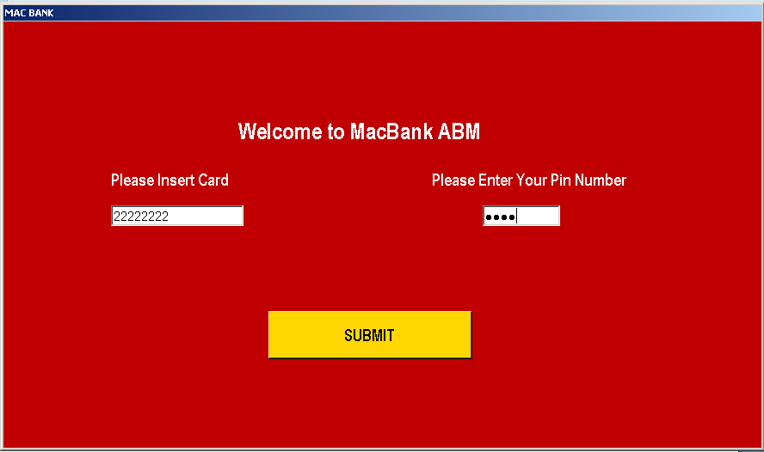
User Interface
Visual Studio (C#)
GUI vs. Command Line
Calling on different classes
  Forms
  Limited access to information
User Functions

Slide 29

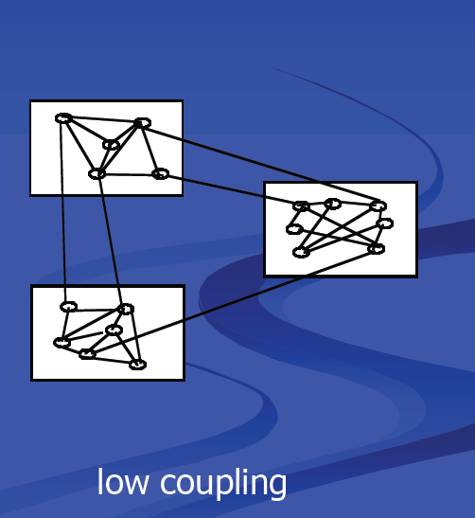
Transactions Class
Basic Functions: Deposit, Withdraw, Transfer, Balance Inquiry.
Supporting functions: Account Initiliazer, Get Balance, Set Balance.
Modularized format.
High cohesion Low coupling between classes.

Slide 30
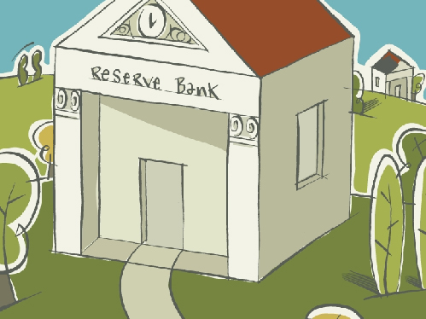
Bank Class
Functions included:
  verify_pin
  verify_card
  Get_Balance
  Set_Balance
  Get_Deposit
  Set_deposit
  Vault_amount
GemBox Application

Slide 31
DEMO

Slide 32

Team Work
Efficient division of Tasks.
Weekly meetings to plan next step and follow up on progress
Dedicated/Passionate team members
Organizational Tools : GANTT Chart.

Slide 33
Organizational Tools: GANTT Chart

Slide 34

Gains from the course
New perception of software design (not just coding).
Transformed basic requirements into a software product.
How to manage projects
Most practical course ever taken; saw material in action.
Requirements

Slide 35
Time Breakdown
Activity | Time (hours)
SRS | 5
SDS High level | 10
SDS low Level | 10
Coding | 30
Debugging | 10
Other | 5
Total | 70

Slide 36

Comments and Suggestions
More parallelism between lectures and labs.
More time for implementation.
Overall great learning experience!

Slide 37
Thank You!
Questions?

Slide 39
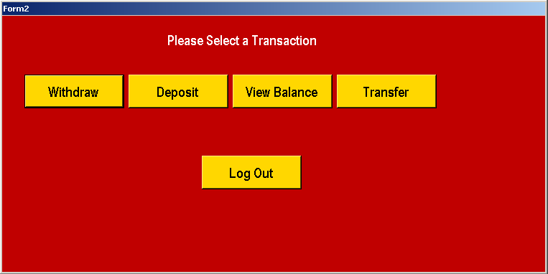

Slide 40
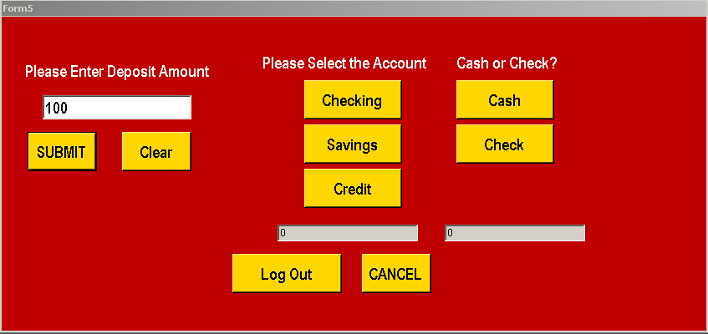

Slide 41
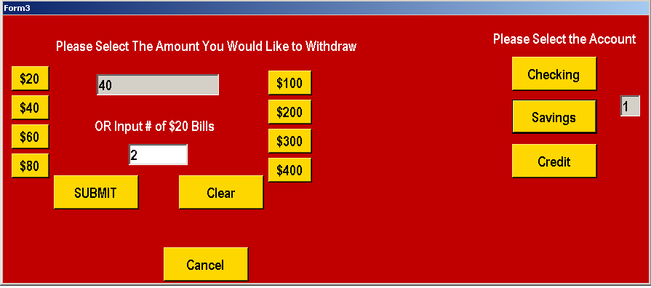

Slide 42
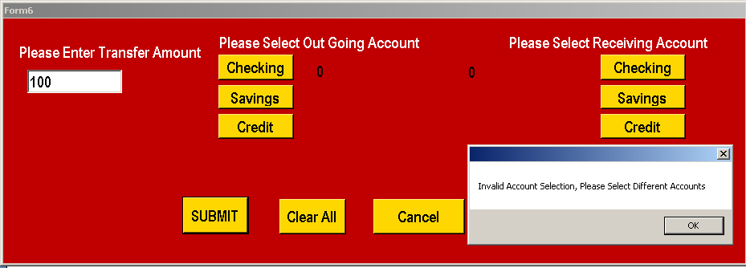

Slide 43
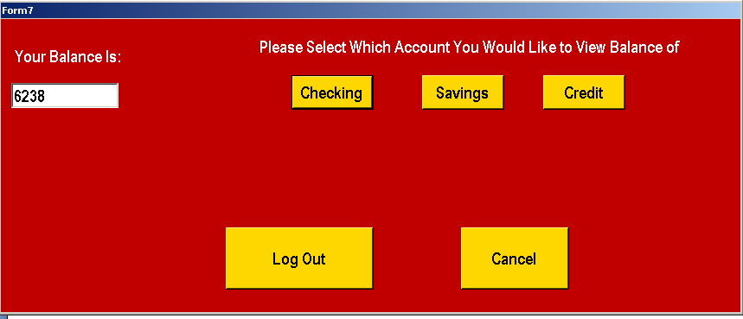

Slide 44
