Slide 1

Macbank ABM
Group 304: Matthew Gardner, Steven Li and Robert Lombardi
Software Eng 3K04
Dr. Kamran Sartipi
December 2, 2009

Slide 2
Overview of Software Engineering
“Multi-person construction of multi-version software” [Parnas 1978]
“Software engineering is an engineering discipline which is concerned with all aspects of software production”
Solve real problems with computer software, using appropriate tools and techniques as well as specified constraints
Maintain ethical practices

Slide 3
Why software engineering?
Solve the software crisis
  Development and maintenance of large and complex software systems
  For every 8 large projects, 2 are cancelled
  Majority of projects go over time by 50%
  75% of large systems malfunction after implementation
  50% of effort is spent on bug testing and fixing
  System maintenance is 60% of cost
Provides a disciplined process and methodologies to design, implement, and maintain large systems

Slide 4
Software Life Cycle Process
From inception of an idea for a product to the end of its life
In General
  Requirements gathering and analysis
  Architecture design and specification
  Coding and testing
  Delivery and deployment
  Maintenance and evolution
  Retirement

Slide 5
Life cycle process –
Waterfall Model
Feasibility study
Requirements
Design
Coding and module testing
Integration and system testing
Delivery, deployment, and maintenance
Properties
  No feedback
  No parallelism
  A single delivery date

Slide 6
Requirement Specification
Benefits:
  Prevents misunderstandings between producer and user
  Prevents misunderstanding between engineers and domain experts about affects on the control function to be implemented
Qualities:
  Precise, clear, unambiguous
  Consistent and complete
  Incremental

Slide 7
Software Requirements Specification from request for proposal
Introduction to Document
  Formatting Conventions
  Naming Conventions for Project
Project Description
  Perspective
  Product Functionality
  Data Flow Diagram
  Users
  Constraints
Specific Requirements
  User Interface
  Hardware Interfaces
  Software/Functional/Behaviour Requirements

Slide 8
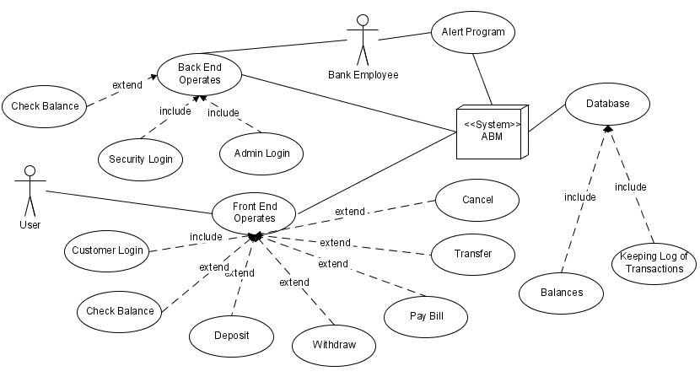
Software Requirements Specification
Behaviour Requirements, Use Case View
Non-Functional Requirements
  Performance
  Safety and Security
  Software Quality Attributes

Slide 9
Software Design Specification
Broke down system requirements from the SRS
  Abstract functional modules
Divided the system into these components:
  User Interface
  Employee Controller
  Customer Controller
  System Controller
  Account Database
Led us to create interfaces to support required interactions

Slide 10
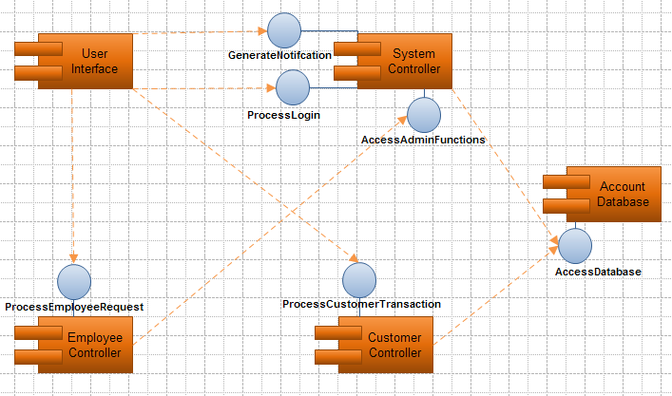
Component Diagram

Slide 11
High-Level Software Design Specification (SDS) Features
Outlines features of all components
  Dependencies described
  Interfaces described
  States described
Statecharts are included for all states of the ABM software

Slide 12
High-Level StateCharts
Withdraw
Customer Menu

Slide 13
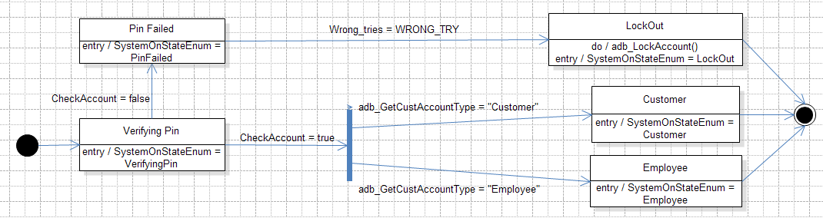
Refining the SDS
Broke down high-level SDS into low-level SDS statechart diagrams
  More detailed than previous state charts
Diagrams describe the events that cause the state changes

Slide 14
Refining the SDS
Describe all Modules in detail
  Used External Modules and Data Types
  Internal State Variables
  Internal Constants
  Exported Functions
  Internal Functions
Focus on how system components would interact and interface

Slide 15
Our Implementation
Web-Based
  HyperText Markup Language (HTML)
  JavaScript
  Active Server Pages (ASP)
  Structured Query Language (SQL)
SQL database
  Created using Microsoft Access
Graphical User Interface (GUI)
  Adobe Photoshop, Illustrator

Slide 16
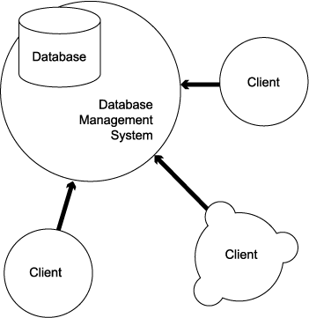
How it all works
Web system based on client/server model
ASP
HTML
SQL
/ JS
Server

Slide 17
The client
The ABM terminal is the client in our implementation (Front End)
Used for user interface display
Uses HTML forms to submit data to the server
Current mode of form submission is “get”
  Transfers data in plain text using web address
  Allows easier debugging of system
  Ideally should use “post” submission method
    Post sends form items in http message which can be secured using https

Slide 18
The Server
Internet Information Services (IIS) provides web server back end
ASP can retrieve HTML form items through the built in request object
  Get uses request.querystring (“ItemName”) to obtain web address variables
  Post uses request.form(“ItemName”) to obtain http message variables
ASP has built in objects and methods to create an object that can interact with a database

Slide 19
The HTML
Able to use images generated by Adobe Photoshop for interface
Adobe slices images up for buttons and textboxes that are html ready
Each web page acts as a sub-state from the high level SDS design
Use HTML forms to submit data to ASP for processing
Add functionality and interaction with JavaScript and ASP

Slide 20
The JavaScript
Provides direct access to HTML form items through the Document Object Model (DOM)
Allows dynamic processing of form items
Allows the user to interact with the web page
Used to create input selection screens for ABM interface
Used to place input into hidden form variables to pass to ASP

Slide 21
The ASP
Allows easy access to/for:
  HTML form variables
  MS Access databases
  Using SQL queries for databases
  Adding dynamics to user interface
Makes all decisions for ABM
Controls are state changes
Provides the link between HTML/JavaScript and SQL

Slide 22
The SQL
Assuming many records need to be maintained, databases are the most efficient method of storing and retrieving the data
Database initially created with Microsoft Access
Use ASP built in Component Object Model (COM) for databases to open a session of communication with database through SQL

Slide 23
Our Implementation
Pros
  Efficient, less code
  Simple style
  Easy to understand
  GUI modifications are simple
  Accomplished requirements
Cons
  Vulnerable to security threats in an unsecure network
  Real life example would run on a very secure intranet only

Slide 24
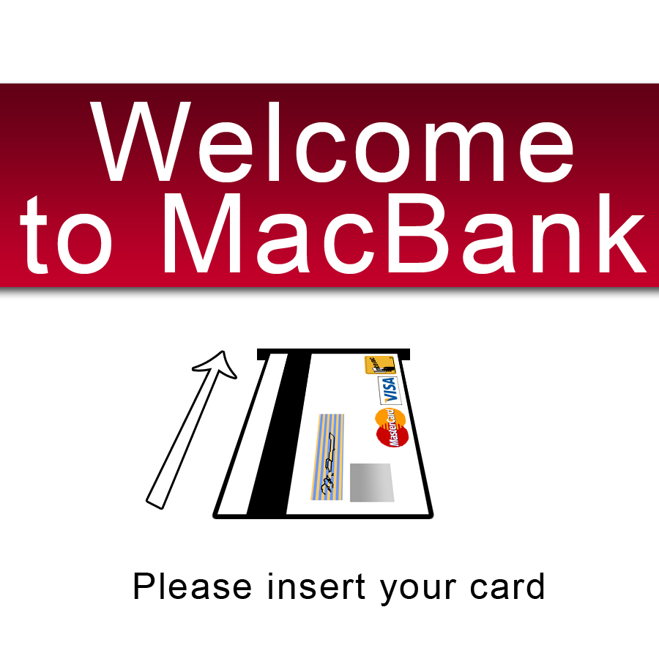
Demonstration
Our ABM System

Slide 25
Conclusion
Teamwork
  Split up work to capitalize on strengths
  Check each others progress and edit documents and code for others, fresh eyes see mistakes
  Team meetings should only be held when progress has been made
Gains and Career Help
  Knowledge of the design process and document types we would otherwise not know about
  Experiencing the full process from design to testing is beneficial and unique
  Our most involved and time-consuming project to date, more realistic in representing work conditions

Slide 26
Conclusion
Gains and Career Help (continued)
  List as a major project on resumes
  Can show potential employers that we have knowledge in Software Engineering besides pure coding skills
Suggestions
  More time for implementation (coding) and testing
  Some mock hardware to interface with to add realism

Slide 27
Questions?

Slide 28
Software Demo

Slide 29
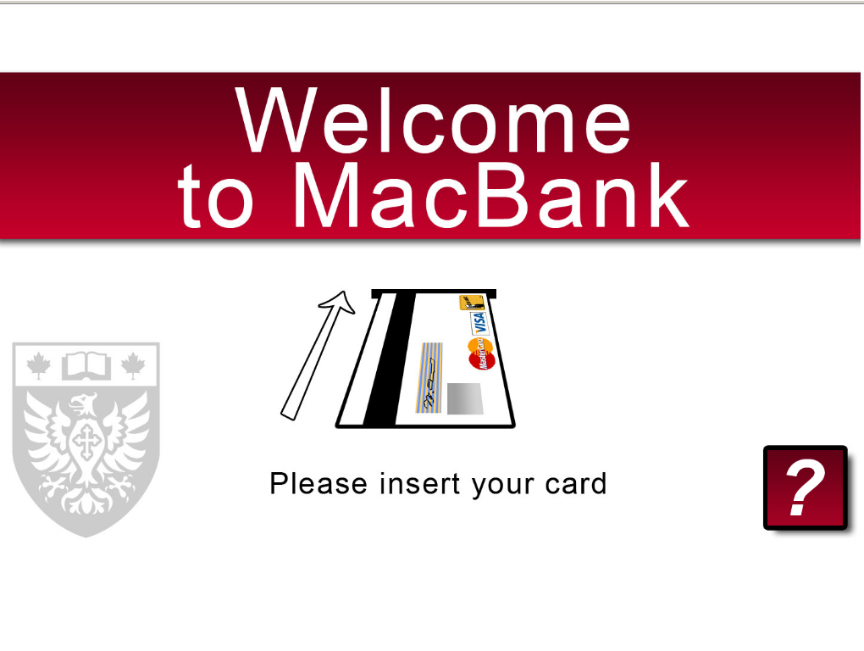

Slide 30
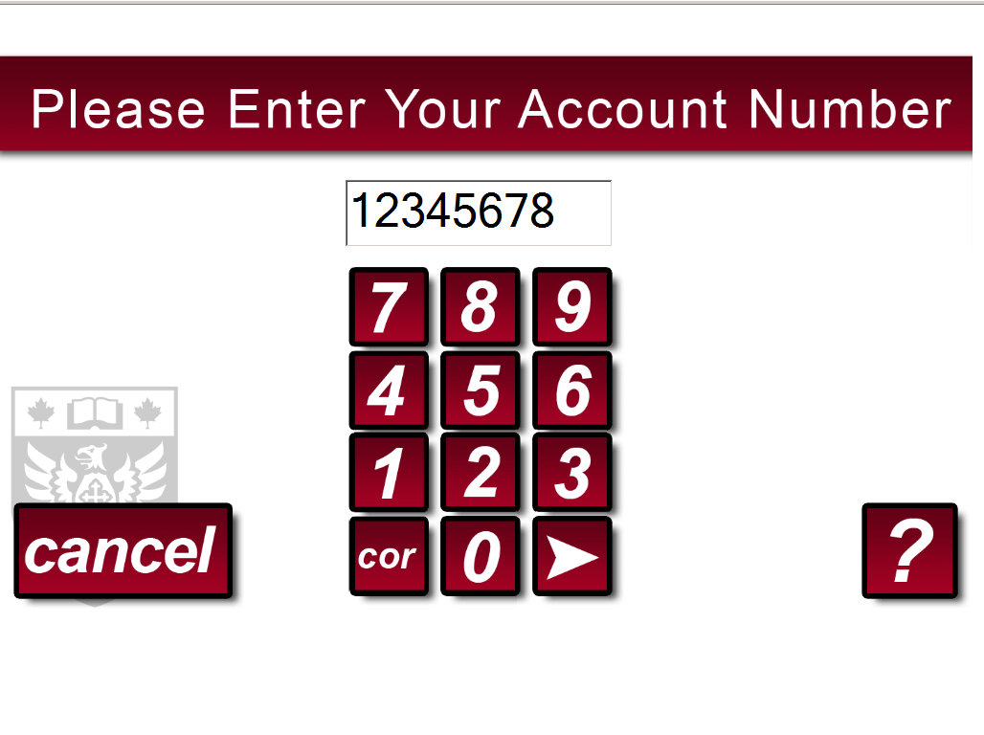

Slide 31
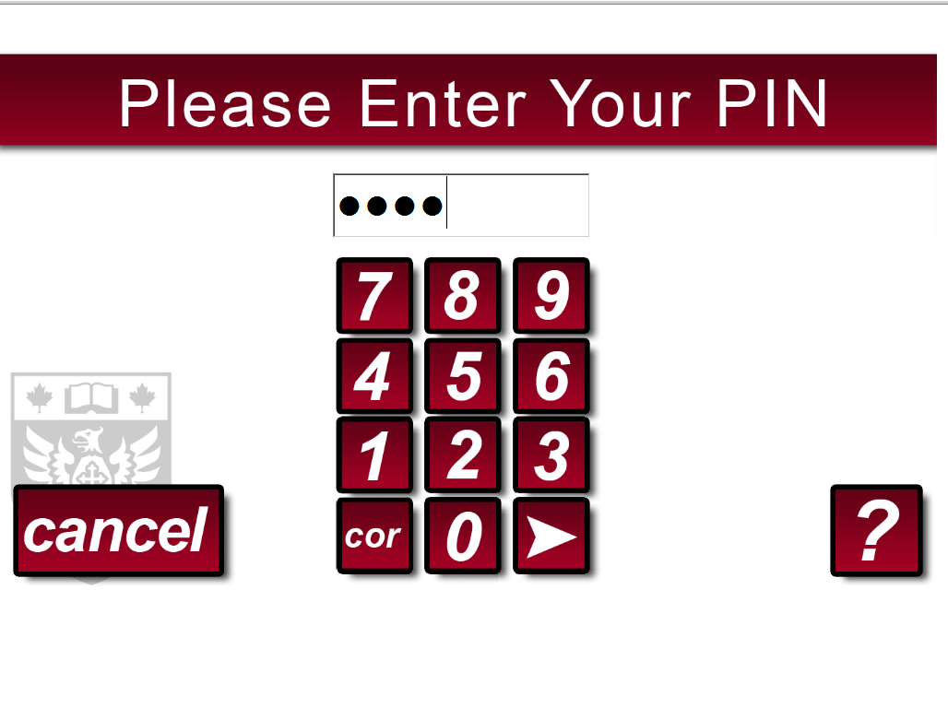

Slide 32
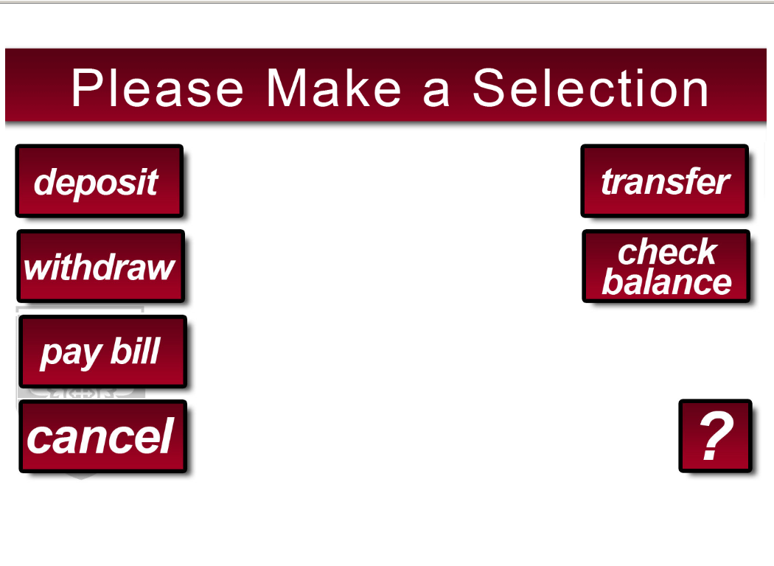

Slide 33


Slide 34
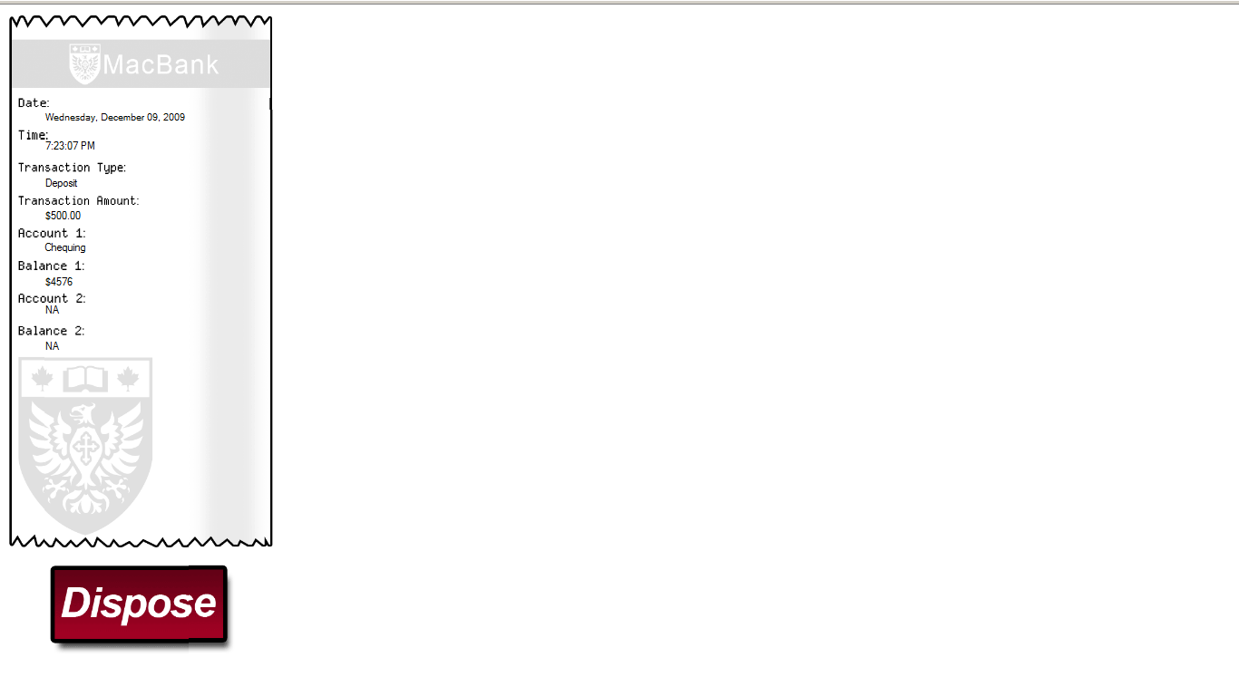

Slide 35
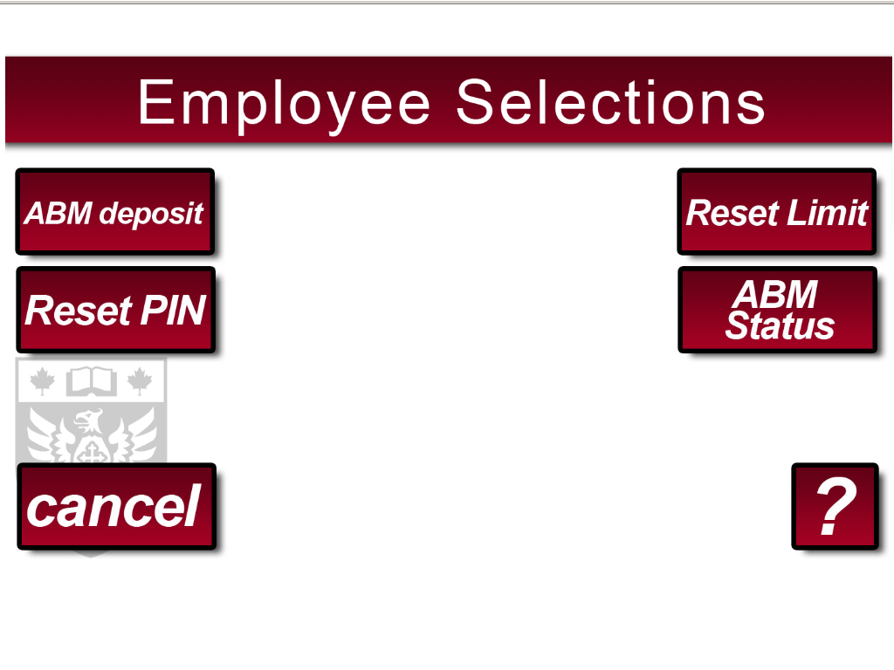

Slide 36
