Slide 1
State Charts
Mehran Najafi

Slide 2
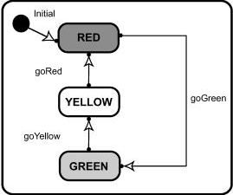
Reactive Systems
A reactive, event-driven, object is one whose behavior is best characterized by its response to events dispatched from outside its context.
Traffic light statechart
Notes:
Statecharts are mostly useful in the design process of reactive systems.
First let me introduce reactive systems briefly.
Based on the written definition, a reactive system is a system that is defined based on its responses to the internal or external events.
To make it more clear, suppose a reactive system that is usually in a state, e.g.,: idle until an event is trigger and makes the object transition from the state to another state.
A simple reactive system would be a traffic light. It has three states (Red, Yellow, and Green). Also there is a timer which generates events. Each event takes the system from a state to other state.
-------------------------------------------------------------------------------------------------------------------------------------------------------------------------------------------------------------------------------------------------------------------

Slide 3
Statechart Diagrams
Graph whose nodes are states and whose directed arcs are transitions labeled by event names.
Describe the dynamic behavior of a system.
Consider a system as a finite state machine.
Statechart Components
Notes:
As I said a statechart is a tool that is used in the design step of software development processes.
And it fits well by the reactive systems requirements.
Each statechart is a graph and consists of a number of nodes and edges.
Nodes (i.e., round rectangles) represent states and each edge (i.e., arrow) shows a transition between two states. Also the events are labels on each transition.
You can see the main components of a statechart in this figure.
Also I should mention that by using statechart each reactive system can be assumed as a finite state machine.
----------------------------------------------------------------------------------------------------------------------------------------------------------------------------------
[finite state machine]

Slide 4
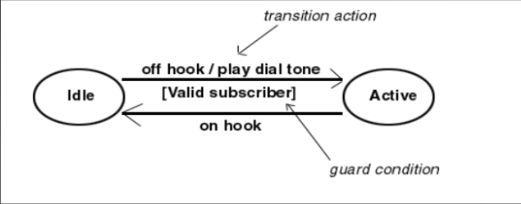
Statechart Components
State – Is the condition of an object at a specific time.
Event – Is an occurrence that triggers the state.
Transition – Involves going from one state to the other when an event occurs.
Event [Guard] / Action
Notes:
So let me give a definition to these components in the statechart context.
State is defined as the condition of an object at a specific time.
As you know, different values of object variables put the object in different states.
Events are defined as relevant occurrences for each state.
When an event happens the state is triggered.
There are different categories of events such as
External Event that caused by an outside actor.
Internal Event that caused by an internal action, inside the system’s boundary.
Temporal Event that are events caused by a determined date or time clock.
Each transition involves going from one state to the other state when an event occurs.
Each transition has three parts.
An event,
,a guard that is a Boolean condition, it means if the event occurs and the condition is satisfied then perform the transition
and an action is best described as a task that takes place within a state. These actions can be in the form of On entry, On exit, Do or On event.

Slide 5
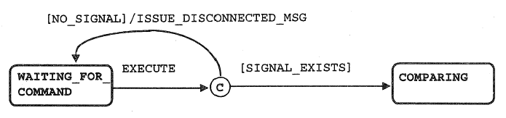
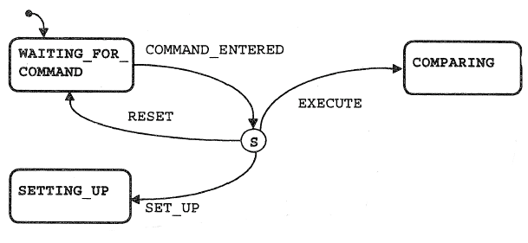
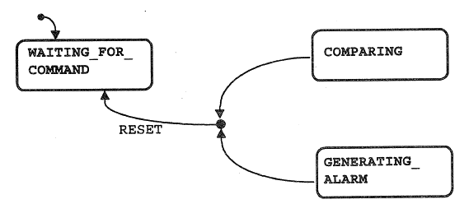
Connectors
Condition Connector
Switch Connector
Junction Connector
Notes:
Transitions can be merged or separated through connectors.
There are three different types of connectors.
Condition Connector that splits a transition into two branches based on a condition. It means when an event occurs there are two transitions whose guard conditions are different.
The second one is switch connector that is usually used with events rather than conditions. In these situations there are more than one events that occurs together and their different combinations can make different transitions.
The third one is junction connector that transits two states to one state if the transition events and guards of the both states are satisfied.

Slide 6
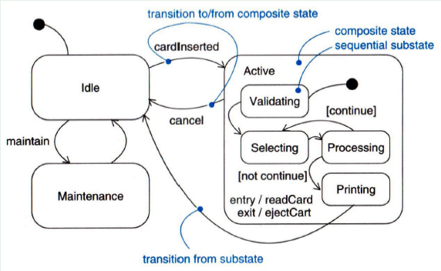
Composite State
Is a state that contains other states.
Simplifies the modeling of complex behaviors.
ATM Statechart
Notes:
In order to have simpler statecharts we are allowed to have composite states.
Each composite state contains a number of substates.
In the other word, you can assume a composite state as an individual statechart. In addition to internal transitions it might have some external transitions.
An incoming transition could go either to the whole composite state (in this case it transits to the initial states inside the composite state) or to a single substate.
Each substate also can have a transition to states outside the composite state. If the transition is from the composite state, it belongs to all of the substates.
So can you tell me how many cancel transitions would be if we wouldn’t have a composite state?
There would be one cancel transition for each substate. It means there would be 4 instead of 1 with composite state.

Slide 7
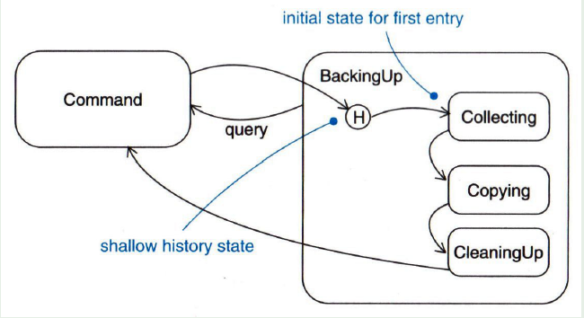
History states
Remember the last substate that the superstate was active in it prior to the transition from the composite state.
Backup process
Notes:
In the case of having a composite state, the composite state can be left by a transition from the composite state at any substate.
In some cases, we would need to remember the last substate where the composite state was active.
It is useful if we want to continue the progress from this substate when we come back later.
The initial notation is substituted by the history notation.
For example, it this figure the backing up process has three sub stages.
The user can cancel each stage by a cancel command and resume working from the last active stage later.

Slide 8
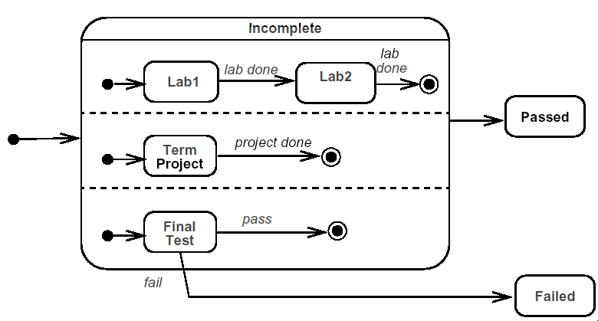
Concurrent substates
Substates execute in parallel
Taking a course
Notes:
In one sense, there are two categories of substates in a superstate.
Sequential substates – that we have seen them in the all previous examples
Concurrent substates – that are used to model concurrency
These allow us to specify two or more state machines that execute in parallel
As you can see in this figure, each subsection has its on initial substate. When the composite state is activated, each section starts simultaneously and makes progress based on their events and their transitions.
In the other side, If one reaches the final state, waits for the other one
If there was not the notion of concurrent substates it would cause the “explosion of states” problem that appears is FSMs.

Slide 9
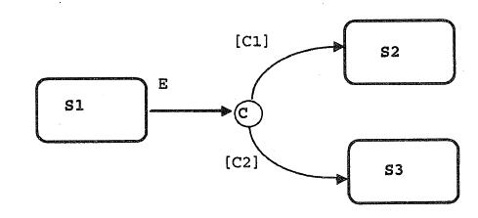
Nondeterministic Situations
If E occurs and both C1 and C2 are true, the system does not know which transition to take.
The implementing tools make an arbitrary decision.
Notes:
The nondeterministic situations can be displayed by statecharts
As you can see in this figure, if event E happens there are two choices, if condition C1 is true it goes to state S2, if C2 is satisfied it goes to S3 but what happens if both C1 and C2 or none of them are true.
So these are some nondeterministic situations that the statechart must deal with them.
The statechart can choose one arbitrary state or define priorities among them.

Slide 10
How to produce statechart diagrams
Identify entities that have complex behavior
Determine initial and final states of the entity
Identify the events that affect the entity
Identify entry and exit actions on states
Expand states using substates
All actions have to be implemented as operations on classes
Notes:
So if you are going to create a statechart diagram for a system what are the steps.
First you need to specify the entities that have complex dynamic behaviors. Objects or classes that are affected by internal or external events.
It is recommended to develop one statechart for each class.
Then find the initial and final states for each entity.
Then we should identify the relevant events.
The next step would be identifying the actions that must be done in the entering point and exit point of the specified states.
Find the other states of the entity rather than the initial and final states and find their corresponding events and actions.
The class operations can show us the actions in the statechart.

Slide 11
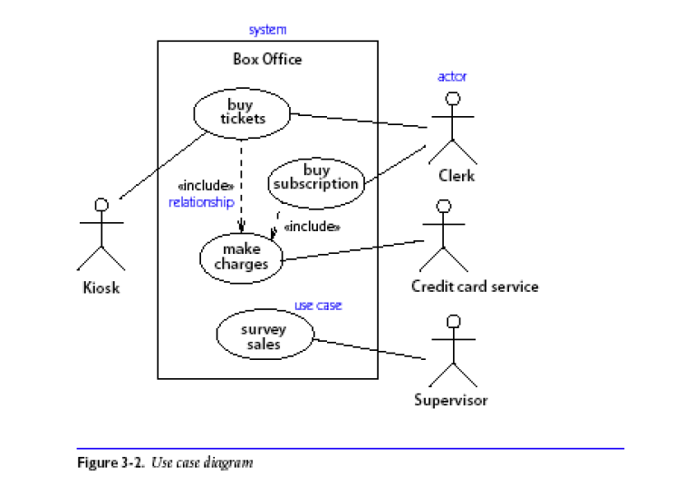

Slide 12
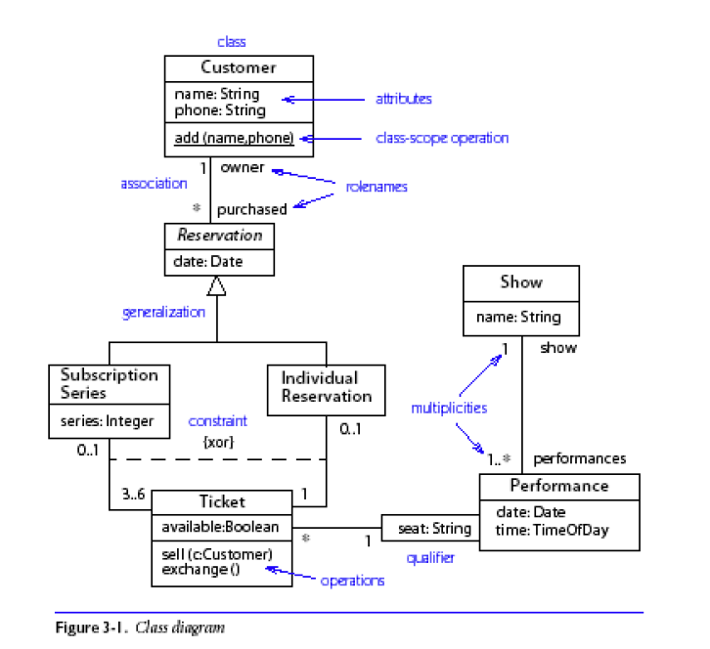

Slide 13
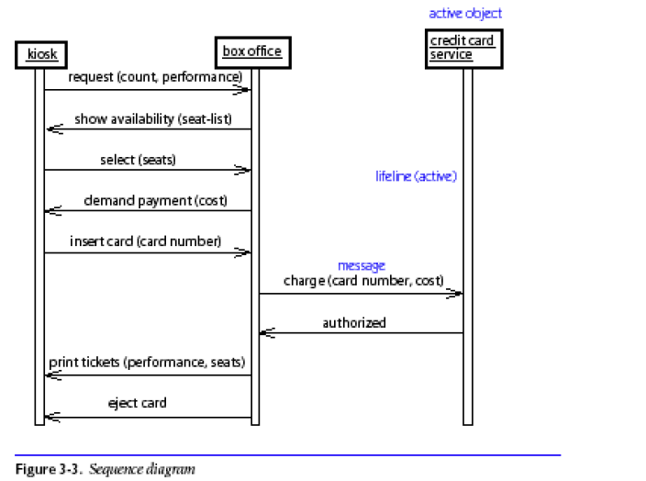

Slide 14
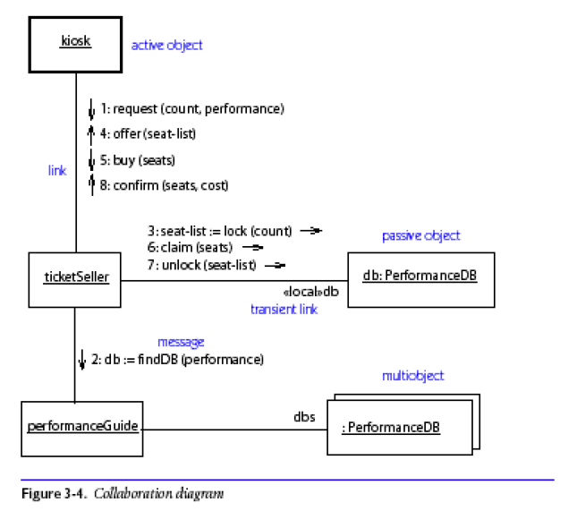

Slide 15
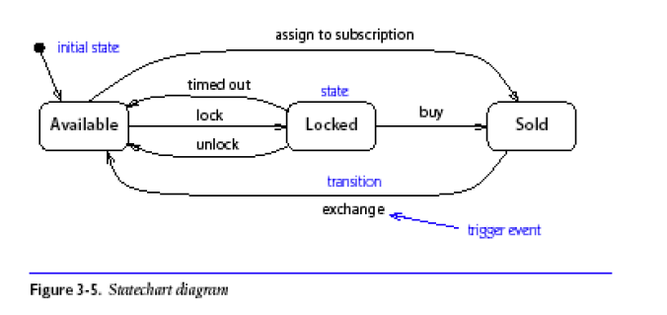

Slide 16
